Slide 1

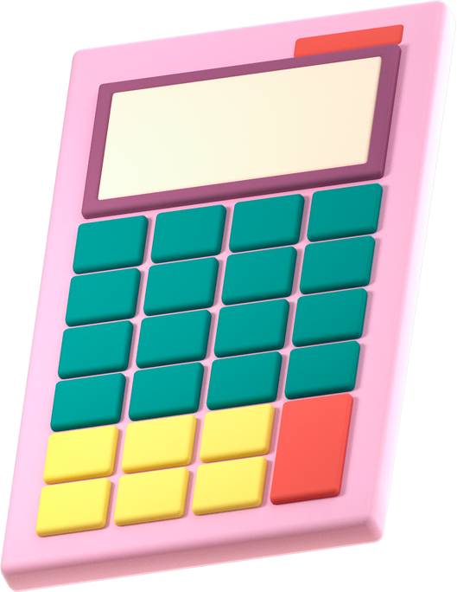

Simple & Compound Interest
Harsha S Vijayakumar

Slide 2
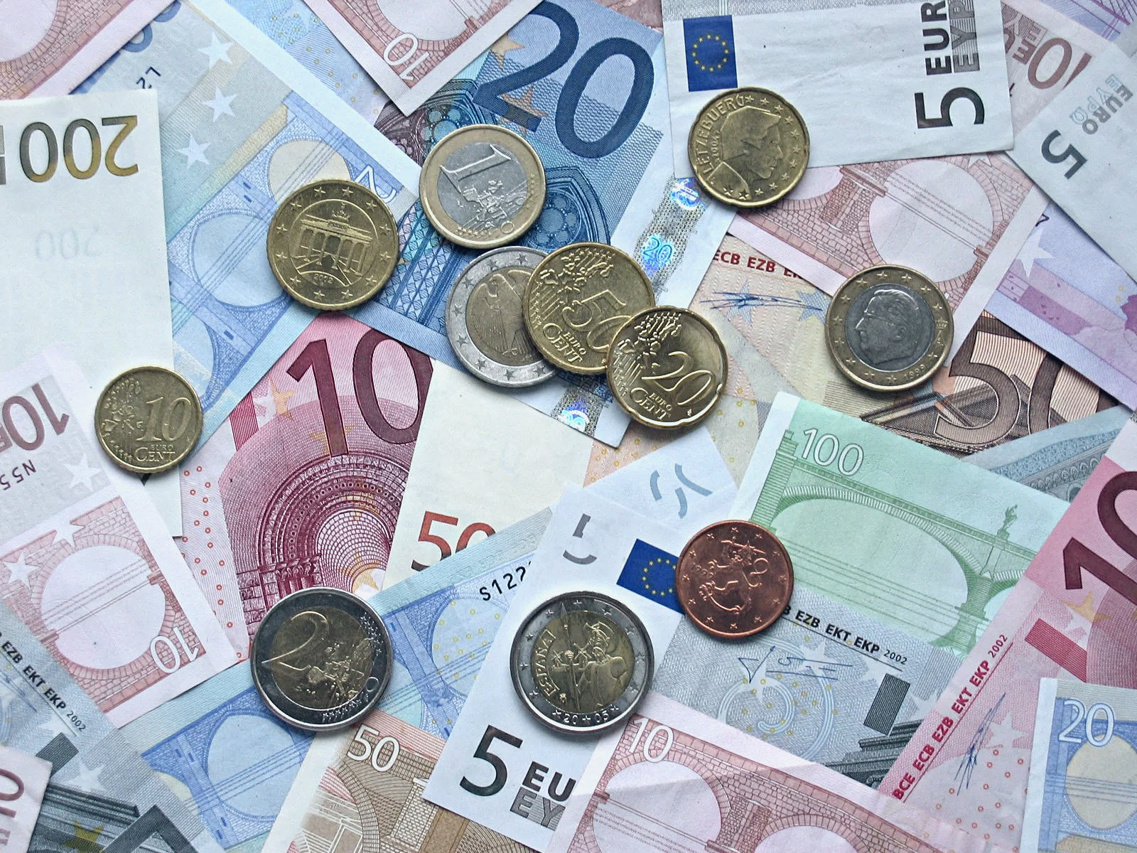



Interest
Interest is money paid to the lender by the borrower for using the lender’s money for a specified period of time.
i) Simple Interest
ii)Compound Interest

Slide 3

Simple Interest
Compound Interest
A= P (1+R/100)^N
CI = P (1+R/100)^N - P
SI=PNR/100
A = P + SI

Slide 4

1)What is the simple interest earned on a sum of ₹40,000 at 15% p.a. for four years?
A.24000
B.12000
C.28000
D.30000

Slide 5

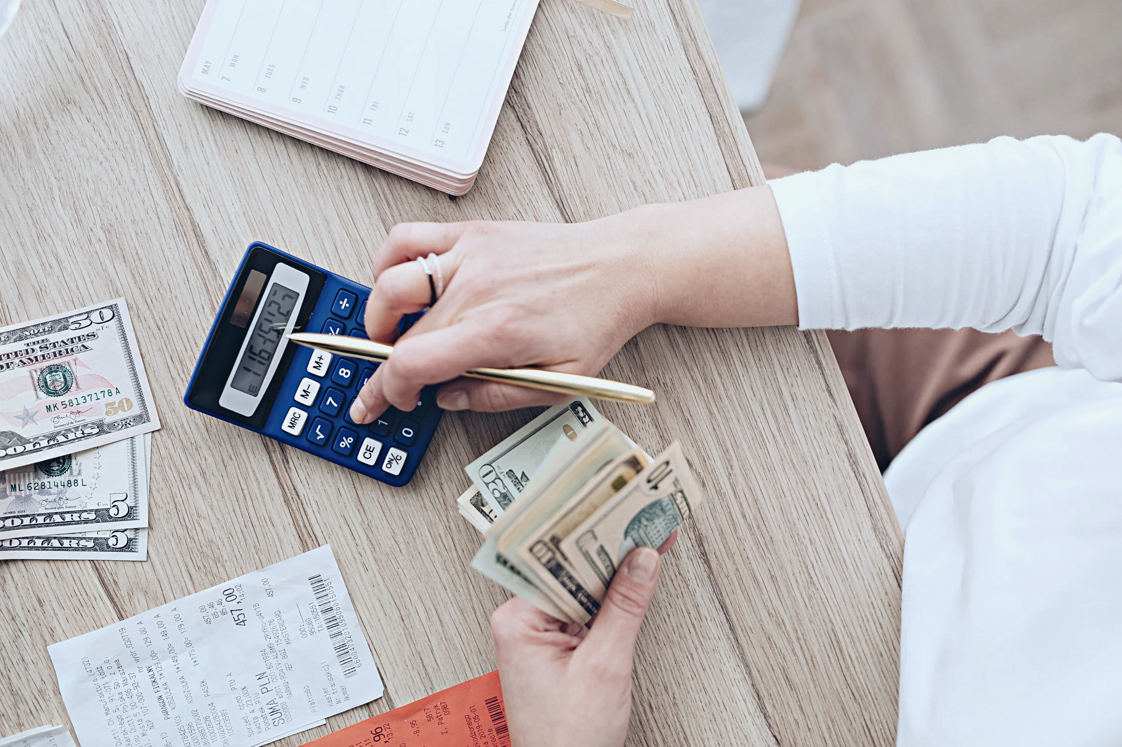



2)What amount does Kiran get if he invests ₹18,000 at 15% p.a. simple interest for four years?
A.24800
B.28800
C.28400
D.26000

Slide 6


3)A certain sum becomes ₹20,720 in four years and 24080 in six years at simple interest. Find the sum and the rate of interest.
A.₹12,000; 12% p.a.
B.₹14,000; 12% p.a.
C.₹12,000; 15% p.a.
D.₹15,000; 10% p.a.

Slide 7

4)In how many years will a sum become seven times itself at 25% p.a. on simple interest?
A.24
B.12
C.18
D.15

Slide 8

5)A certain sum becomes four times itself atsimple interest in eight years. In how many years does it become ten times itself?
A.21
B.25
C.24
D.27

Slide 9
6)What amount does Kiran get if he invests
(a)₹8,000 at 10% p.a. on compound interest for two years, compounding done annually?
A.₹9,630 B.₹9,680 C.₹9,610 D.₹9,650
(b)₹2,400 at 20% p.a. on compound interest for 1 year, compounding done semiannually?
A.₹2,924 B.₹2,904 C.₹2,954 D.₹2,944

Slide 10
7)At what rate of interest will an amount be doubled in two years, when compounded annually?
A.30%
B.41.4%
C.45.2%
D.73.2%

Slide 11
8)The compound interest earned on a sum for the second and the third years are ₹1,200 and ₹1,440 respectively. Find the rate of interest.
A.18%
B.20%
C.24%
D.15%

Slide 12
9)Find the difference between the simple interest and compound interest at16% p.a. on a sum of ₹50,000 at the end of the first two years.
A.1220
B.1420
C.1280
D.1250

Slide 13
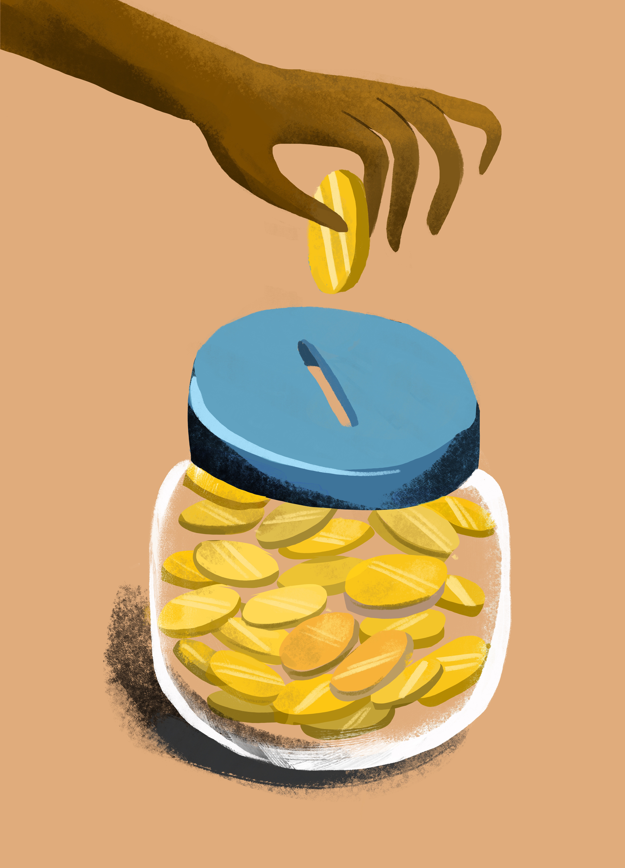
Thank you!

Slide 14




Resource
Page
Use these icons and illustrations in your Canva Presentation. Happy designing! Don't forget to delete this page before presenting.

